Slide 1

Slide 1
SEABORN LIBRARY
Sarah Abdelmoaty

Slide 2
seaborn.catplot
seaborn.catplot(*, x=None, y=None, hue=None, data=None, row=None, col=None, col_wrap=None, estimator=<function mean at 0x7fecadf1cee0>, ci=95, n_boot=1000, units=None, seed=None, order=None, hue_order=None, row_order=None, col_order=None, kind='strip', height=5, aspect=1, orient=None, color=None, palette=None, legend=True, legend_out=True, sharex=True, sharey=True, margin_titles=False, facet_kws=None, **kwargs)
This function provides access to several axes-level functions that show the relationship between a numerical and one or more categorical variables using one of several visual representations.

Slide 3
Parameters
x, y, hue : names of variables in data
Inputs for plotting long-form data. See examples for interpretation.
Data : DataFrame
Long-form (tidy) dataset for plotting. Each column should correspond to a variable, and each row should correspond to an observation.
row, col : names of variables in data, optional
Categorical variables that will determine the faceting of the grid.
col_wrap : int
“Wrap” the column variable at this width, so that the column facets span multiple rows. Incompatible with a row facet.
Estimator : callable that maps vector -> scalar, optional
Statistical function to estimate within each categorical bin.
Ci : float or “sd” or None, optional
Size of confidence intervals to draw around estimated values. If “sd”, skip bootstrapping and draw the standard deviation of the observations. If None, no bootstrapping will be performed, and error bars will not be drawn.
n_boot : int, optional
Number of bootstrap iterations to use when computing confidence intervals.
Units : name of variable in data or vector data, optional
Identifier of sampling units, which will be used to perform a multilevel bootstrap and account for repeated measures design.
Seed : int, numpy.random.Generator, or numpy.random.RandomState, optional
Seed or random number generator for reproducible bootstrapping.
order, hue_order : lists of strings, optional
Order to plot the categorical levels in, otherwise the levels are inferred from the data objects.
row_order, col_order : lists of strings, optional
Order to organize the rows and/or columns of the grid in, otherwise the orders are inferred from the data objects.

Slide 4
Kind : str, optional
The kind of plot to draw, corresponds to the name of a categorical axes-level plotting function. Options are: “strip”, “swarm”, “box”, “violin”, “boxen”, “point”, “bar”, or “count”.
Height : scalar
Height (in inches) of each facet. See also: aspect.
Aspect : scalar
Aspect ratio of each facet, so that aspect * height gives the width of each facet in inches.
Orient : “v” | “h”, optional
Orientation of the plot (vertical or horizontal). This is usually inferred based on the type of the input variables, but it can be used to resolve ambiguitiy when both x and y are numeric or when plotting wide-form data.
Color: matplotlib color, optional
Color for all of the elements, or seed for a gradient palette.
Palette : palette name, list, or dict
Colors to use for the different levels of the hue variable. Should be something that can be interpreted by color_palette(), or a dictionary mapping hue levels to matplotlib colors.
Legend : bool, optional
If True and there is a hue variable, draw a legend on the plot.
legend_out : bool
If True, the figure size will be extended, and the legend will be drawn outside the plot on the center right.
share{x,y} : bool, ‘col’, or ‘row’ optional
If true, the facets will share y axes across columns and/or x axes across rows.
margin_titles : bool
If True, the titles for the row variable are drawn to the right of the last column. This option is experimental and may not work in all cases.
facet_kws : dict, optional
Dictionary of other keyword arguments to pass to FacetGrid.
Kwargs : key, value pairings
Other keyword arguments are passed through to the underlying plotting function.
Returns
G : FacetGrid
Returns the FacetGrid object with the plot on it for further tweaking.

Slide 5

Slide 10
Your logo
5

Slide 6
Slide 10
Your logo
6

Slide 7
Slide 10
Your logo
7

Slide 8
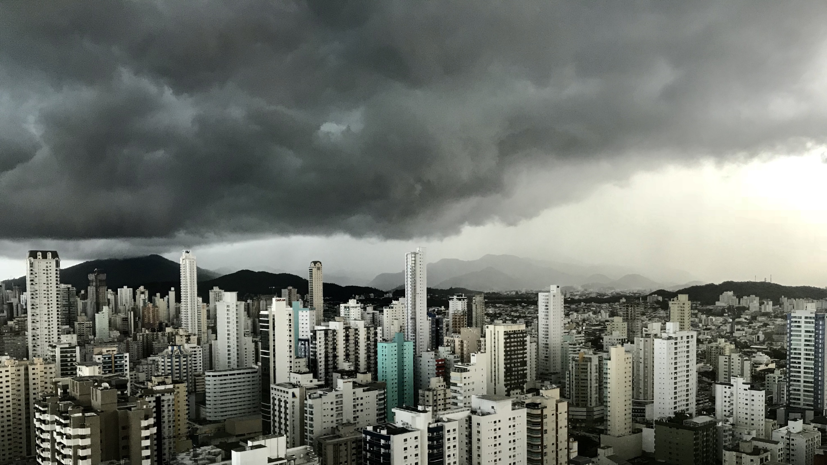
Slide 11
THANK YOU

